Slide 1
Rockbuster Stealth
Business Insights + Data Analysis

Slide 2
Introduction
Competition from streaming services has eaten Rockbuster market share. The company plans to use existing movie licenses to launch an online video rental service but needs to answer some key questions:
Which movies contributed the most/least to revenue gain?
What was the average rental duration for all videos?
Which countries are Rockbuster customers based in?
Where are customers with a high lifetime value based?
Do sales figures vary between geographic regions?

Slide 3



Overview
Data from 2/14/2007 - 5/14/2007
599 Customers
108 Countries
597 Cities
16044 rentals
958 titles
2 stores
$61,312.04 in sales
14,596 sales made
$4.20 avg per sale

Slide 4
Quick Look - Rental Stats
 | Min | Max | Avg | Count
Duration | 3 | 7 | 4.99 | 1000
Rate | .99 | 4.99 | 2.98 | 1000
Length | 46 | 185 | 115.27 | 1000
Cost | 9.99 | 29.99 | 19.98 | 1000

Slide 5
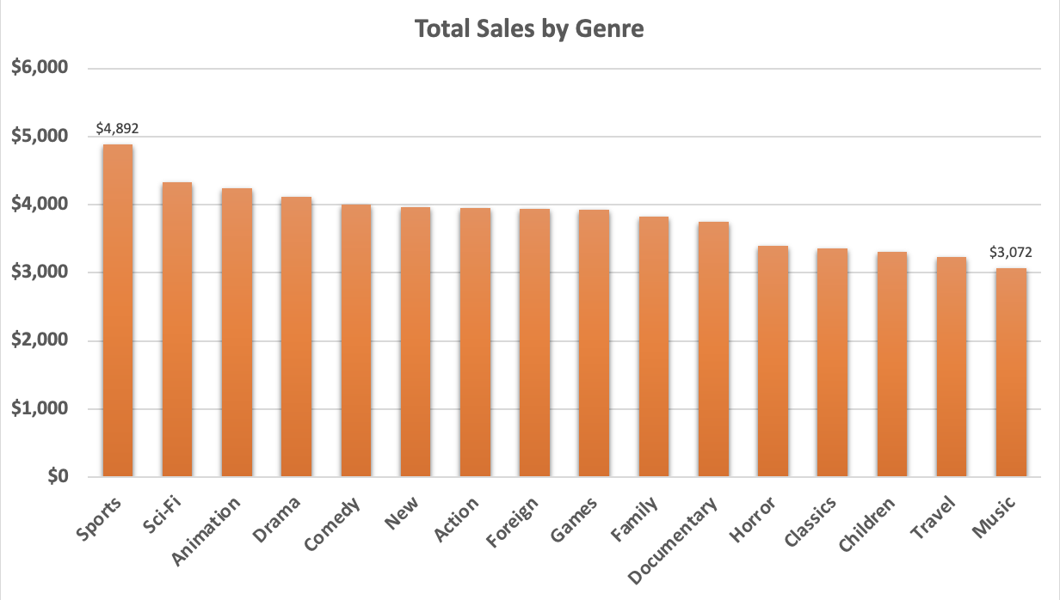
Popular Genres
Sports brought in the highest sales at $4,892.
Music brought in the lowest at $3,072

Slide 6
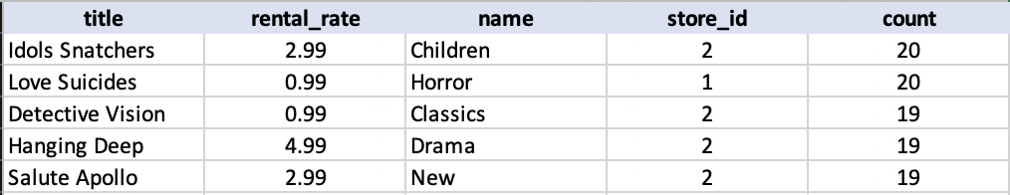
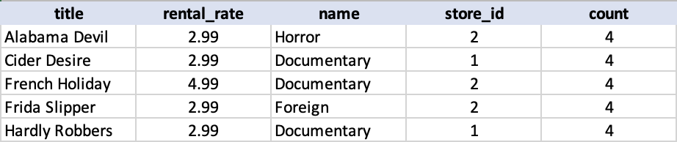
Best/Worst Selling Titles
BEST TITLES
WORST TITLES

Slide 7
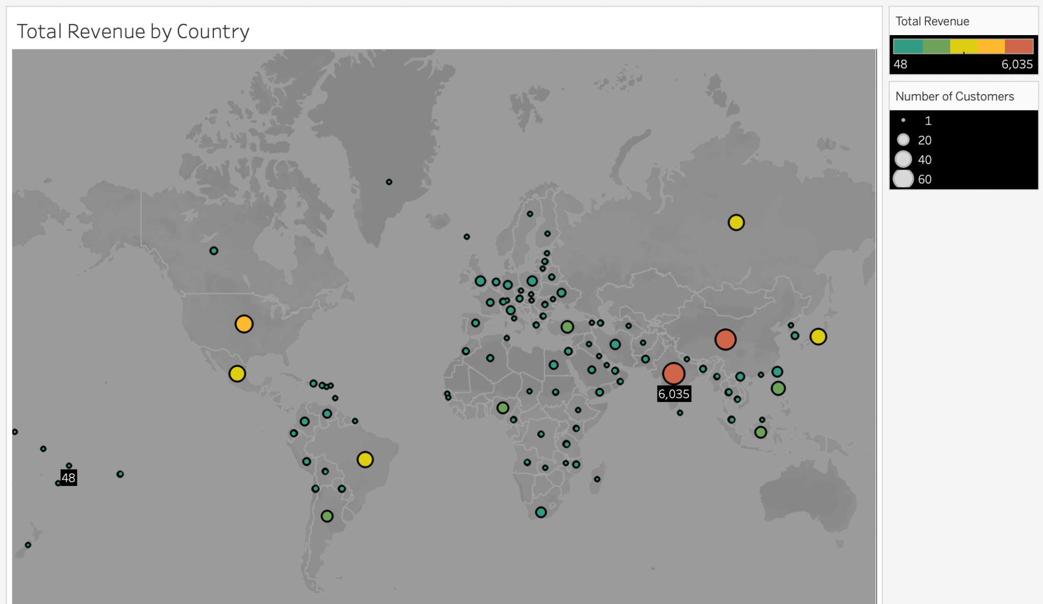
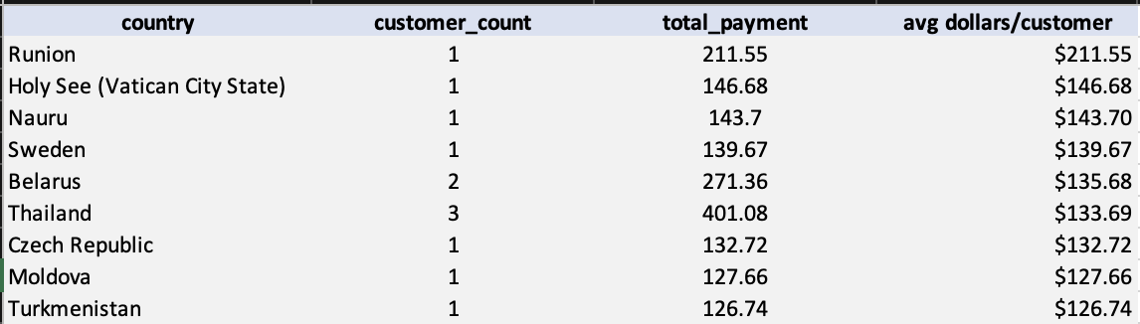
Geographic Insights
India had the highest number of customers (60) and revenue ($6034.78) followed by:
China - 53, $5251.03
US - 36, $3685.31
Japan - 31, $3122.51
Mexico - 30, $2984.82
Brazil - 28, $2919.19
Russian Federation - 28, $2765.62
Philippines - 20, $2219.70
Turkey - 15, $1498.49
Indonesia - 14, $1352.69
HOWEVER
When evaluating by highest revenue/customer: Runion, Holy See, Nauru, Sweden and Belarus were the top 5 countries.
https://public.tableau.com/shared/6XXXMMKTR?:display_count=n&:origin=viz_share_link

Slide 8
Lifetime Value Customers
Top 5 customers from the top 10 cities.
Name | Country | City | Total Paid
Arlene Harvey | India | Ambattur | $111.76
Kyle Spurlock | China | Shanwei | $109.71
Marlene Welch | Japan | Iwaki | $106.77
Glen Talbert | Mexico | Acua | $100.77
Clinton Buford | United States | Aurora | $98.76

Slide 9
CONCLUSIONS
RECOMMENDATIONS
599 customers across 108 countries and 597 cities via 2 stores
$61,312.04 in sales with $4.20 avg/sale
Average rental rate is 2.98 and average length of rental is 115.27
The Sports genre made the most at $4892, while Music mad the least at $3072
India, China and the United States have the most customers, but their revenue per customer was relatively low
Select customers have high lifetime value
Focus on the highest revenue genres initially.
Initiate rollout in the countries with the highest customer counts
Encourage customer loyalty with incentives
Research:
why revenue/customer is so low in the leading countries
the relationship between rental rate and inventory availability

